Slide 1

CSC334 - Parallel & Distributed Computing
Chapter 7: Consistency and Replication
Mr. Aoun Haider, Ms. Muntaha Amjad

Slide 2
Consistency and replication
Introduction
Replication
Why replicate
Assume a simple model in which we make a copy of a specific part of a system (meaning code and data).
Increase reliability: if one copy does not live up to specifications, switch over to the other copy while repairing the failing one.
Performance: simply spread requests between different replicated parts to keep load balanced, or to ensure quick responses by taking proximity into account.
The problem
Having multiple copies, means that when any copy changes, that change should be made at all copies: replicas need to be kept the same, that is, be kept consistent.
Reasons for replication

Slide 3
Consistency and replication
Introduction
Performance and scalability
Main issue
To keep replicas consistent, we generally need to ensure that all conflicting operations are done in the the same order everywhere
Conflicting operations: From the world of transactions
Read–write conflict: a read operation and a write operation act concurrently
Write–write conflict: two concurrent write operations
Issue
Guaranteeing global ordering on conflicting operations may be a costly operation, downgrading scalability. Solution: weaken consistency requirements so that hopefully global synchronization can be avoided
Reasons for replication

Slide 4
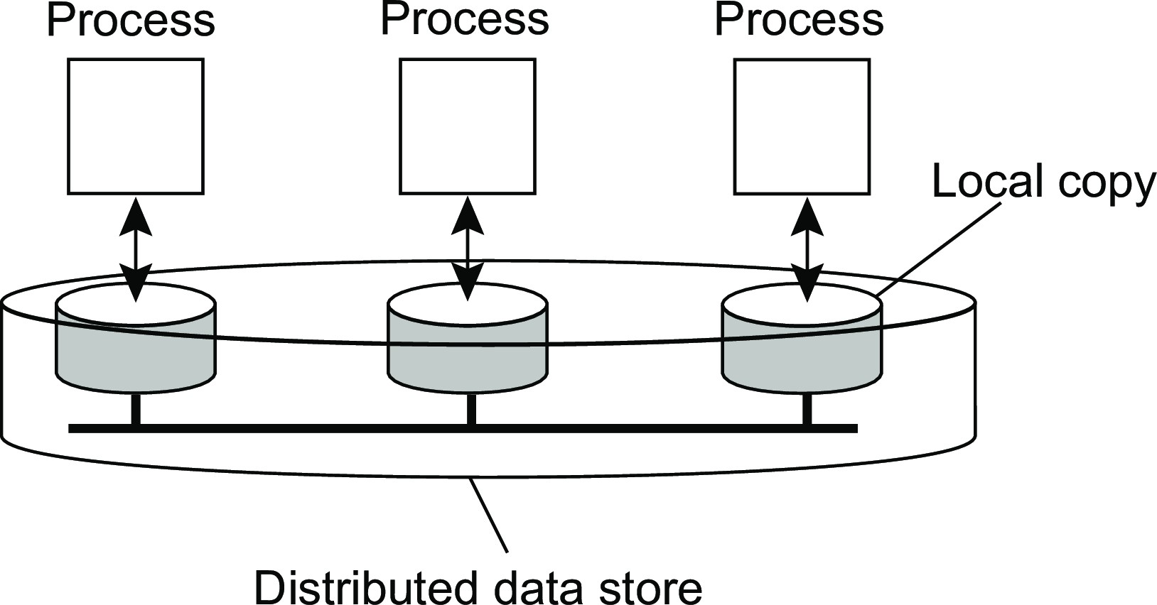
Data-centric consistency models
Consistency and replication Data-centric consistency models
Consistency model
A contract between a (distributed) data store and processes, in which the data store specifies precisely what the results of read and write operations are in the presence of concurrency.
Essential
A data store is a distributed collection of storages:

Slide 5
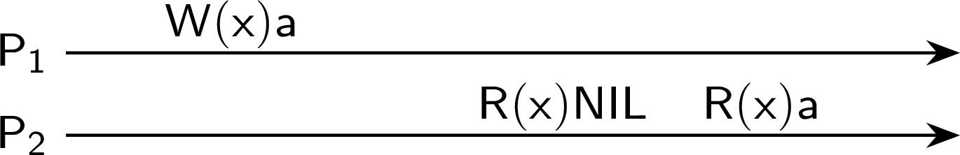
Consistency and replication
Data-centric consistency models
Some notations
Read and write operations
W_{i} (x )a: Process P_{i} writes value a to data item x
R_{i} (x )b: Process P_{i} reads value b from data item x
All data items initially have value NIL
Possible behavior
We omit the index when possible and draw according to time (x-axis):
Consistent ordering of operations

Slide 6
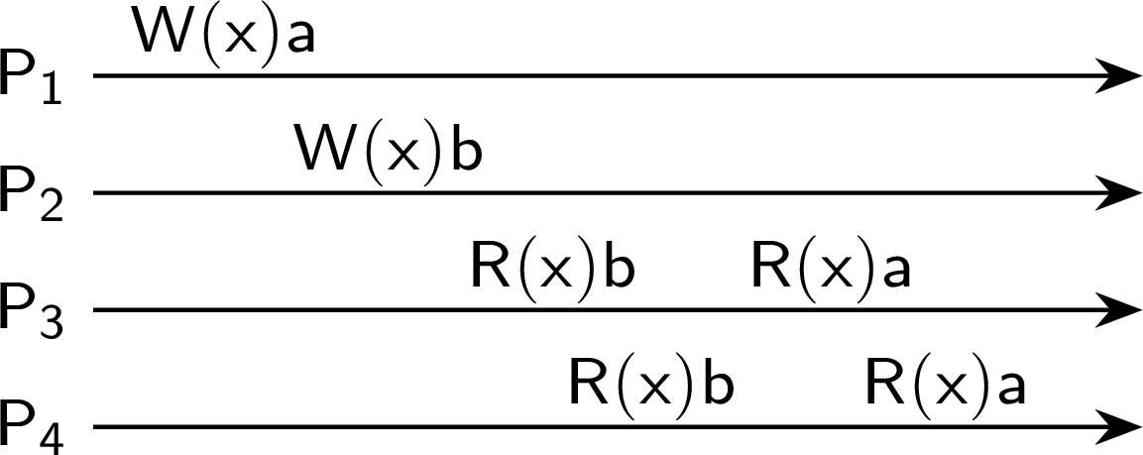

Sequential consistency
Consistency and replication Data-centric consistency models
Definition
The result of any execution is the same as if the operations of all processes were executed in some sequential order, and the operations of each individual process appear in this sequence in the order specified by its program.
A sequentially consistent data store
A data store that is not sequentially consistent
Consistent ordering of operations

Slide 7
Consistency and replication
Data-centric consistency models
Example
Three concurrent processes (initial values: 0)
Process P₁ | Process P₂ | Process P₃
x ← 1; | y ← 1; | z ← 1;
print(y,z); | print(x,z); | print(x,y);
Consistent ordering of operations

Slide 8
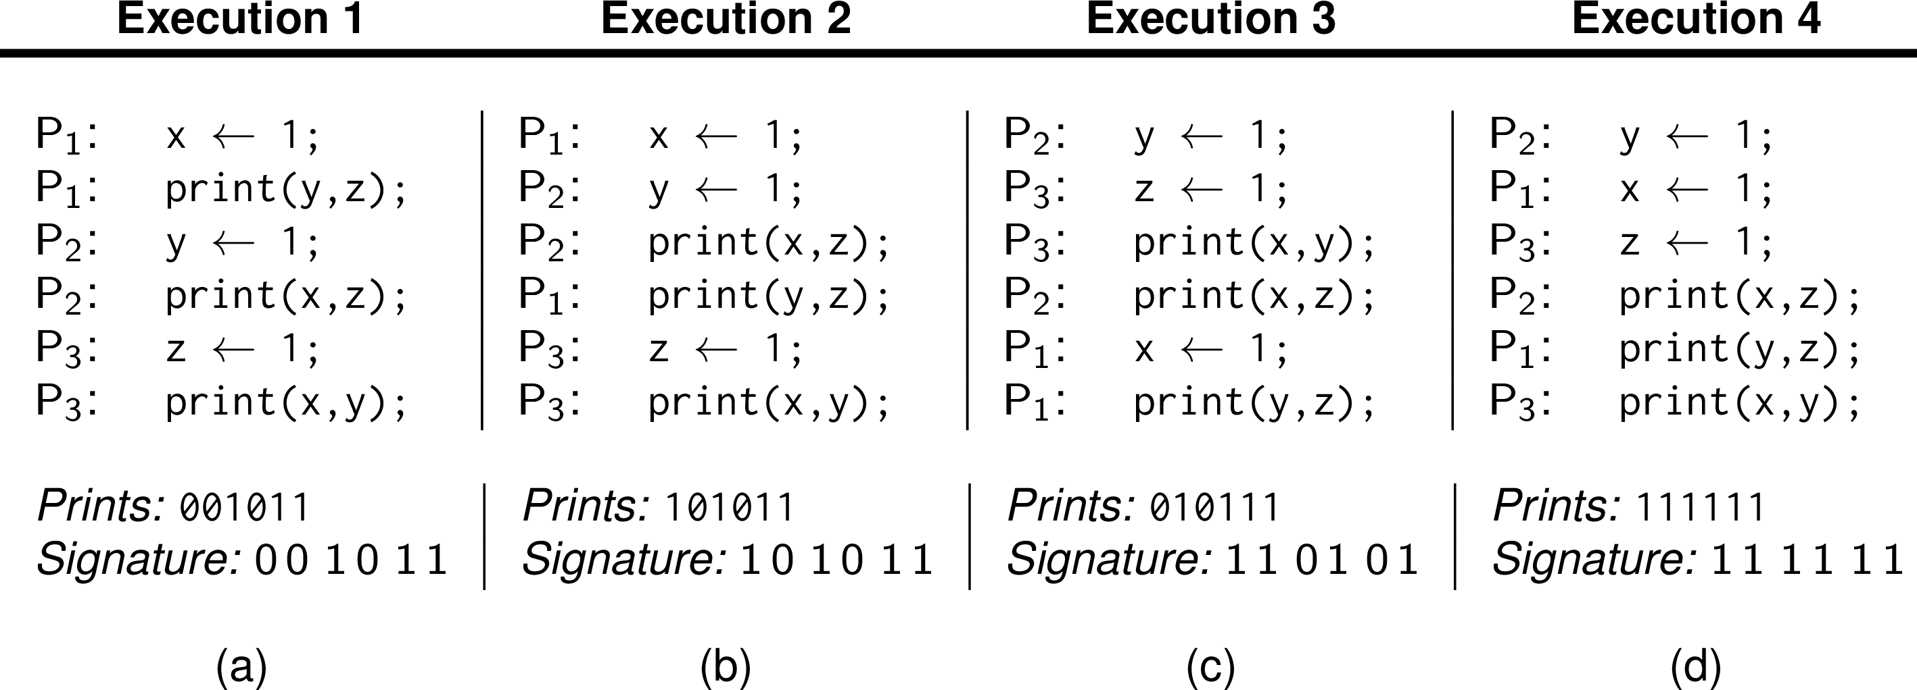
Consistency and replication
Data-centric consistency models
Example
Three concurrent processes (initial values: 0)
Process P₁ | Process P₂ | Process P₃
x ← 1; | y ← 1; | z ← 1;
print(y,z); | print(x,z); | print(x,y);
Example execution sequences
Consistent ordering of operations

Slide 9
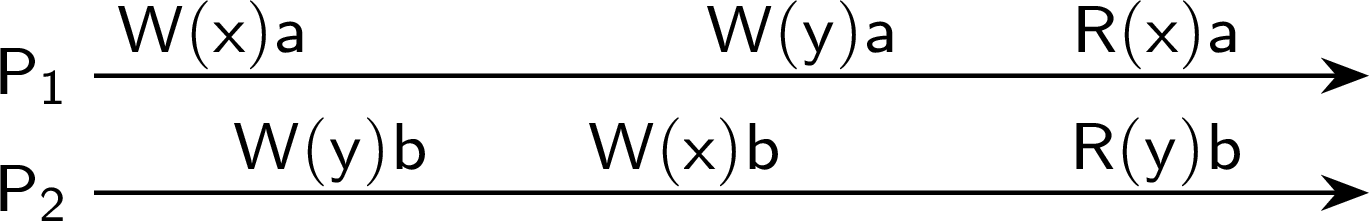
Consistency and replication
Data-centric consistency models
How tricky can it get?
Seemingly okay
Consistent ordering of operations

Slide 10
Consistency and replication
Data-centric consistency models
How tricky can it get?
Seemingly okay
But not really (don’t forget that P₁ and P₂ act concurrently)
Possible ordering of operations |  |  |  | Result
W₁(x )a; | W₁(y )a; | W₂ (y )b; | W₂ (x )b | R₁(x )b | R₂ (y )b
W₁(x )a; | W₂ (y )b; | W₁(y )a; | W₂ (x )b | R₁(x )b | R₂ (y )a
W₁(x )a; | W₂ (y )b; | W₂ (x )b; | W₁(y )a | R₁(x )b | R₂ (y )a
W₂ (y )b; | W₁(x )a; | W₁(y )a; | W₂ (x )b | R₁(x )b | R₂ (y )a
W₂ (y )b; | W₁(x )a; | W₂ (x )b; | W₁(y )a | R₁(x )b | R₂ (y )a
W₂ (y )b; | W₂ (x )b; | W₁(x )a; | W₁(y )a | R₁(x )a | R₂ (y )a
Consistent ordering of operations

Slide 11
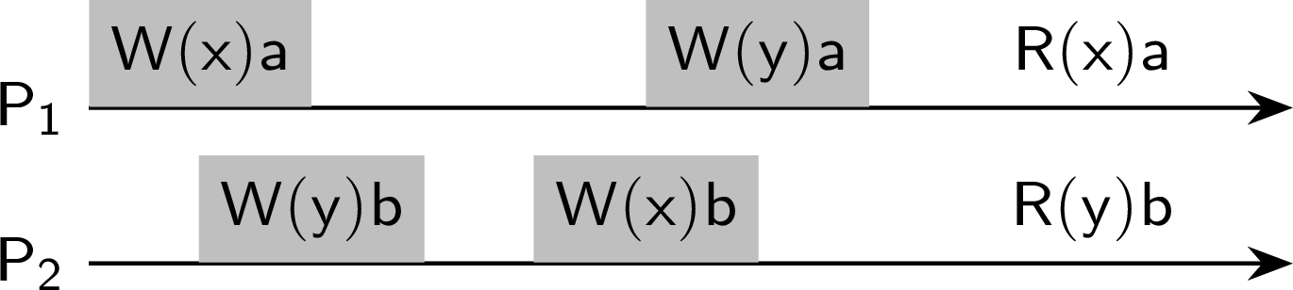
How tricky can it get?
Consistency and replication Data-centric consistency models
Linearizability
Each operation should appear to take effect instantaneously at some moment between its start and completion.
Operations complete within a given time (shaded area)
With better results
Possible ordering of operations |  |  |  | Result
W₁(x )a; | W₂ (y )b; | W₁(y )a; | W₂ (x )b | R₁(x )b | R₂ (y )a
W₁(x )a; | W₂ (y )b; | W₂ (x )b; | W₁(y )a | R₁(x )b | R₂ (y )a
W₂ (y )b; | W₁(x )a; | W₁(y )a; | W₂ (x )b | R₁(x )b | R₂ (y )a
W₂ (y )b; | W₁(x )a; | W₂ (x )b; | W₁(y )a | R₁(x )b | R₂ (y )a
Consistent ordering of operations
Notes:
Effect/Result of each operation should be propagated in real-time.

Slide 12
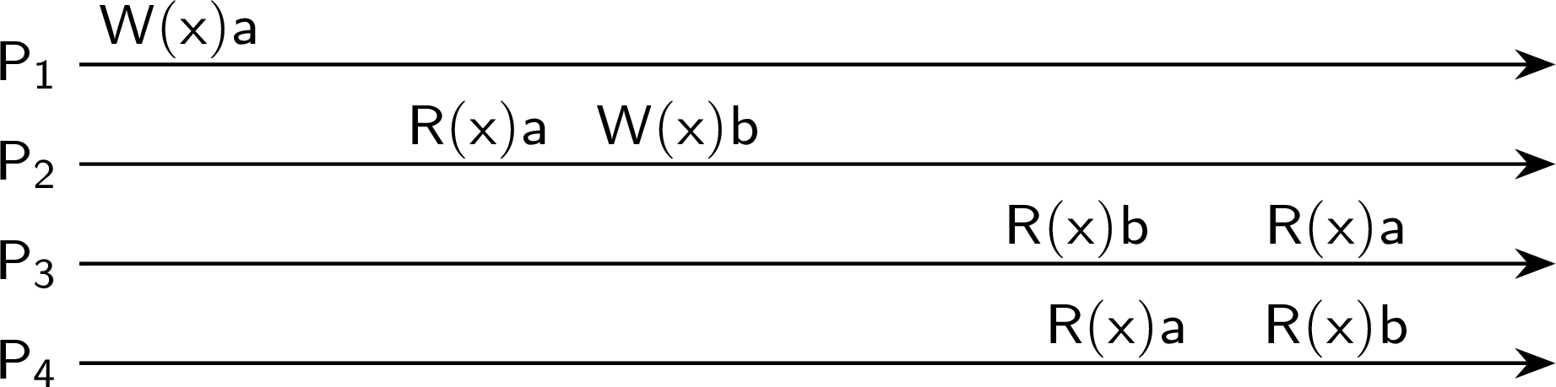
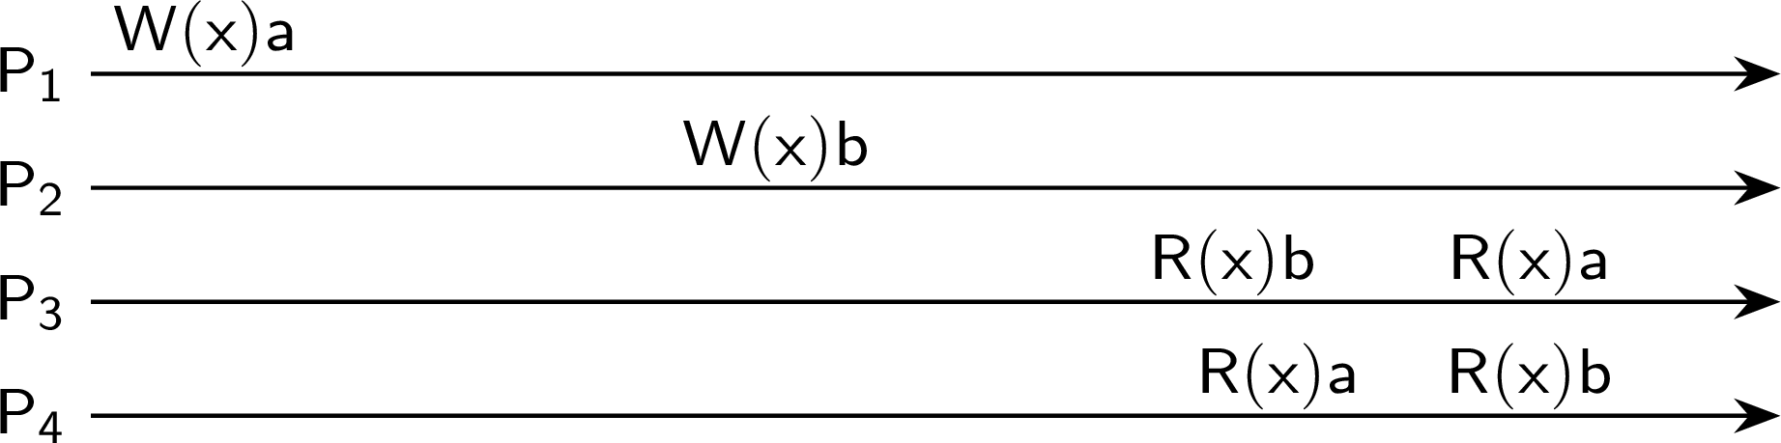
Causal consistency
Consistency and replication Data-centric consistency models
Definition
Writes that are potentially causally related must be seen by all processes in the same order. Concurrent writes may be seen in a different order by different processes.
A violation of a causally-consistent store
A correct sequence of events in a causally-consistent store
Consistent ordering of operations

Slide 13
Consistency models, serializability, transactions
Consistency and replication Data-centric consistency models
Overwhelming, but often already known
Again, from the world of transactions: can we order the execution of all operations in a set of transactions in such a way that the final result matches a serial execution of those transactions? The keyword is serializability.
BEGIN TRANSACTION | BEGIN TRANSACTION | BEGIN TRANSACTION
x = 0 | x = 0 | x = 0
x = x + 1 | x = x + 2 | x = x + 3
END TRANSACTION | END TRANSACTION | END TRANSACTION
Transaction T₁ | Transaction T₂ | Transaction T₃
A number of schedules
 | Time −→
S1 | x = 0 | x = x + 1 | x = 0 | x = x + 2 | x = 0 | x = x + 3 | Legal
S2 | x = 0 | x = 0 | x = x + 1 | x = x + 2 | x = 0 | x = x + 3 | Legal
S3 | x = 0 | x = 0 | x = x + 1 | x = 0 | x = x + 2 | x = x + 3 | Illegal
S4 | x = 0 | x = 0 | x = x + 3 | x = 0 | x = x + 1 | x = x + 2 | Illegal
Consistent ordering of operations

Slide 14
Grouping operations
Consistency and replication Data-centric consistency models
Entry consistency: Definition
Accesses to locks are sequentially consistent.
No access to a lock is allowed to be performed until all previous writes have completed everywhere.
No data access is allowed to be performed until all previous accesses to locks have been performed.
Consistent ordering of operations

Slide 15
Grouping operations
Consistency and replication Data-centric consistency models
Entry consistency: Definition
Accesses to locks are sequentially consistent.
No access to a lock is allowed to be performed until all previous writes have completed everywhere.
No data access is allowed to be performed until all previous accesses to locks have been performed.
Basic idea
You don’t care that reads and writes of a series of operations are immediately known to other processes. You just want the effect of the series itself to be known.
Consistent ordering of operations

Slide 16
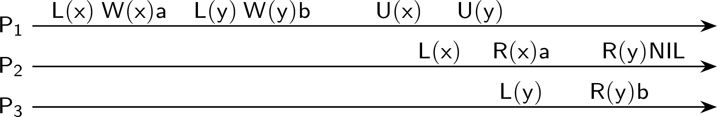
Consistency and replication
Data-centric consistency models
Grouping operations
A valid event sequence for entry consistency
Observation
Entry consistency implies that we need to lock and unlock data (implicitly or not).
Question
What would be a convenient way of making this consistency more or less transparent to programmers?
Consistent ordering of operations

Slide 17
Eventual consistency
Consistency and replication Data-centric consistency models
Definition
Consider a collection of data stores and (concurrent) write operations. The strores are eventually consistent when in lack of updates from a certain moment, all updates to that point are propagated in such a way that replicas will have the same data stored (until updates are accepted again).
Srong eventual consistency
Basic idea: if there are conflicting updates, have a globally determined resolution mechanism (for example, using NTP, simply let the “most recent” update win).
Program consistency
P is a monotonic problem if for any input sets S and T , P(S) ⊆ P(T ). Observation: A program solving a monotonic problem can start with incomplete information, but is guaranteed not to have to roll back when missing information becomes available. Example: filling a shopping cart.
Eventual consistency

Slide 18
Eventual consistency
Consistency and replication Data-centric consistency models
Definition
Consider a collection of data stores and (concurrent) write operations. The strores are eventually consistent when in lack of updates from a certain moment, all updates to that point are propagated in such a way that replicas will have the same data stored (until updates are accepted again).
Srong eventual consistency
Basic idea: if there are conflicting updates, have a globally determined resolution mechanism (for example, using NTP, simply let the “most recent” update win).
Program consistency
P is a monotonic problem if for any input sets S and T , P(S) ⊆ P(T ). Observation: A program solving a monotonic problem can start with incomplete information, but is guaranteed not to have to roll back when missing information becomes available. Example: filling a shopping cart.
Important observation
In all cases, we are avoiding global synchronization.
Eventual consistency

Slide 19
Continuous Consistency
Consistency and replication Data-centric consistency models
We can actually talk about a degree of consistency
replicas may differ in their numerical value
replicas may differ in their relative staleness
there may be differences regarding (number and order) of performed update operations
Conit
Consistency unit ⇒ specifies the data unit over which consistency is to be measured.
Continuous consistency
Notes:
Staleness of replica: How old replica is, sometimes a few hours old replica is acceptable in case of whether data which changes after hours approximately.

Slide 20
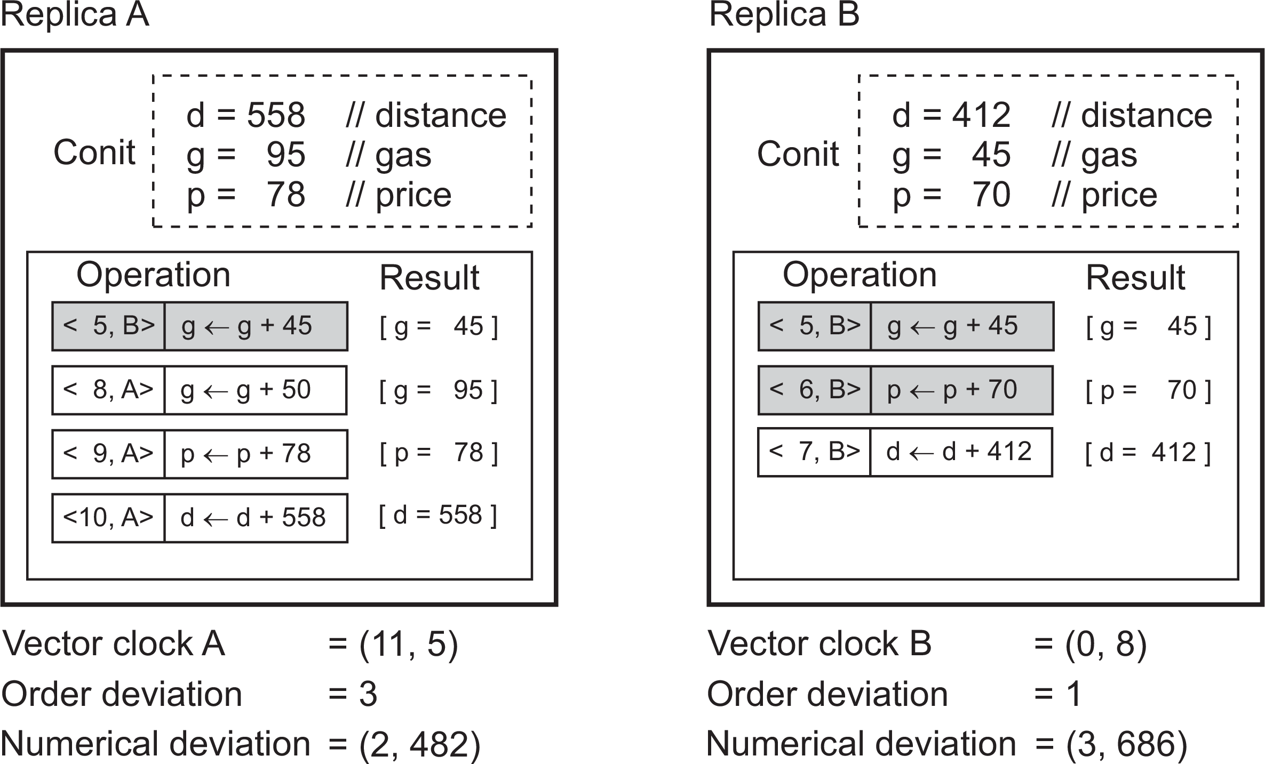
Consistency and replication
Data-centric consistency models
Example: Conit
Conit (contains the variables g, p, and d )
Each replica has a vector clock: ([known] time @ A, [known] time @ B)
B sends A operation [⟨5, B⟩ : g ← d + 45]; A has made this operation permanent (cannot be rolled back)
Continuous consistency

Slide 21
Consistency and replication
Data-centric consistency models
Example: Conit
Conit (contains the variables g, p, and d )
A has three pending operations ⇒ order deviation = 3
A missed two operations from B; max diff is 70 + 412 units ⇒ (2, 482)
Continuous consistency

Slide 22
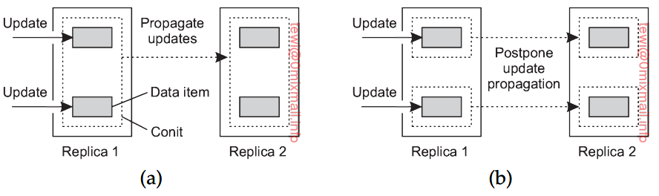
Consistency and replication
Granularity of Conit
Size of conit makes update propagation difficult.
Too small => performance overhead
Too large => update propagation delay

Slide 23
Consistency for mobile users
Consistency and replication Client-centric consistency models
Example
Consider a distributed database to which you have access through your notebook. Assume your notebook acts as a front end to the database.
At location A you access the database doing reads and updates.
At location B you continue your work, but unless you access the same server as the one at location A, you may detect inconsistencies:
your updates at A may not have yet been propagated to B
you may be reading newer entries than the ones available at A
your updates at B may eventually conflict with those at A

Slide 24
Consistency for mobile users
Consistency and replication Client-centric consistency models
Example
Consider a distributed database to which you have access through your notebook. Assume your notebook acts as a front end to the database.
At location A you access the database doing reads and updates.
At location B you continue your work, but unless you access the same server as the one at location A, you may detect inconsistencies:
your updates at A may not have yet been propagated to B
you may be reading newer entries than the ones available at A
your updates at B may eventually conflict with those at A
Note
The only thing you really want is that the entries you updated and/or read at A, are in B the way you left them in A. In that case, the database will appear to be consistent to you.

Slide 25
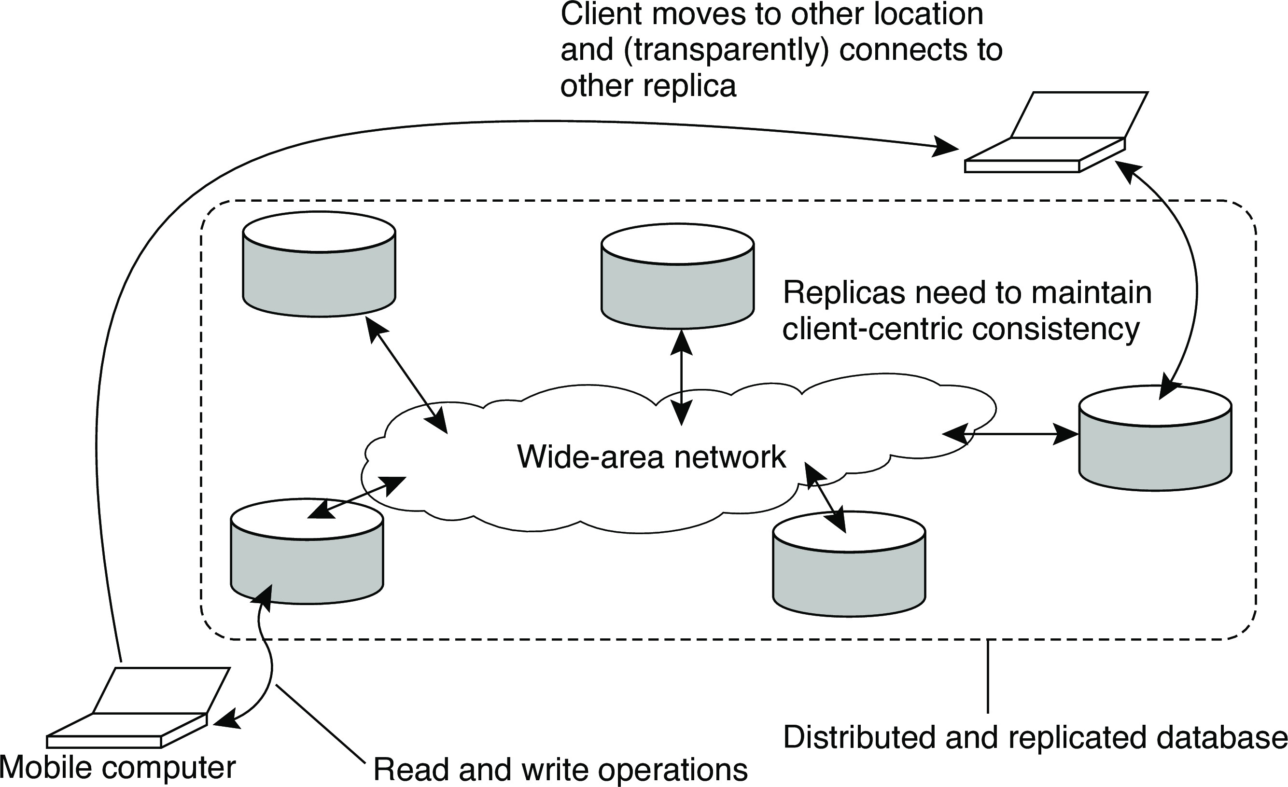
Basic architecture
Consistency and replication Client-centric consistency models
The principle of a mobile user accessing different replicas of a distributed database

Slide 26
Client-centric consistency: notation
Consistency and replication Client-centric consistency models
Notations
W₁(x₂ ) is the write operation by process P₁ that leads to version x₂ of x
W₁(x_{i} ; x_{j} ) indicates P₁ produces version x_{j} based on a previous version
x_{i} .
W₁(x_{i} |x_{j} ) indicates P₁ produces version x_{j} concurrently to version x_{i} .
Monotonic reads

Slide 27
Monotonic reads
Consistency and replication Client-centric consistency models
Example
Automatically reading your personal calendar updates from different servers. Monotonic reads guarantees that the user sees all updates, no matter from which server the automatic reading takes place.
Example
Reading (not modifying) incoming mail while you are on the move. Each time you connect to a different e-mail server, that server fetches (at least) all the updates from the server you previously visited.
Monotonic reads

Slide 28
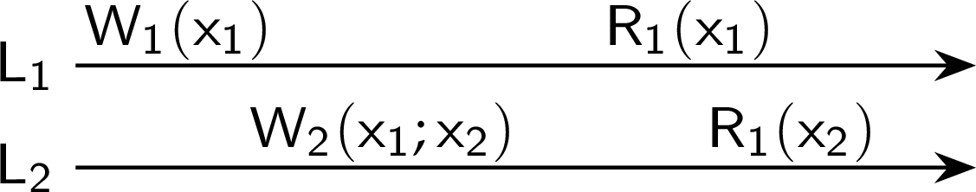
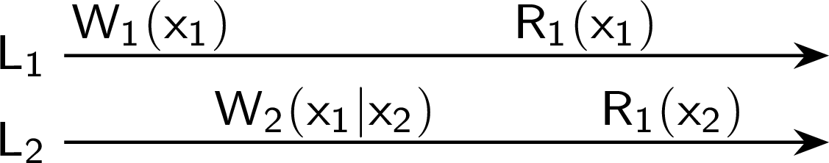
Monotonic reads
Consistency and replication Client-centric consistency models
Definition
If a process reads the value of a data item x , any successive read operation on
x by that process will always return that same or a more recent value.
A monotonic-read consistent data store
A data store that does not provide monotonic reads
Monotonic reads
Notes:
It does not matter from which server user is reading the replica, he must get the up-to-date result.

Slide 29
Monotonic writes
Consistency and replication Client-centric consistency models
Example
Updating a program at server S₂ , and ensuring that all components on which compilation and linking depends, are also placed at S₂ .
Example
Maintaining versions of replicated files in the correct order everywhere (propagate the previous version to the server where the newest version is installed).
Monotonic writes
Notes:
New write must wait old one to finish first.
Write operations by the same process are performed in same order in which they were initiated.
Commutative operations => order not matters, operations can be performed in any order (weaker form of monotonic write)

Slide 30
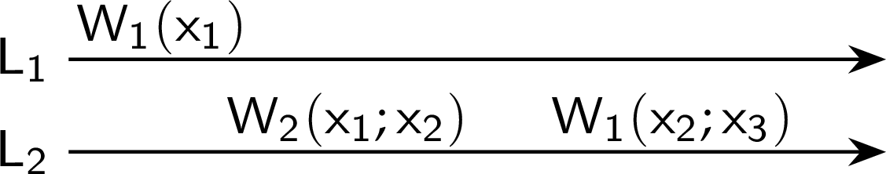
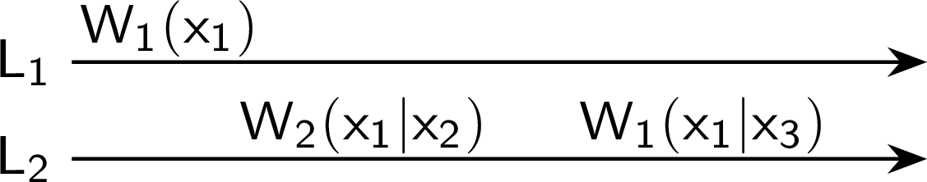


Monotonic writes
Consistency and replication Client-centric consistency models
Definition
A write operation by a process on a data item x is completed before any successive write operation on x by the same process.
OK
Not OK
Not OK
OK
Monotonic writes

Slide 31
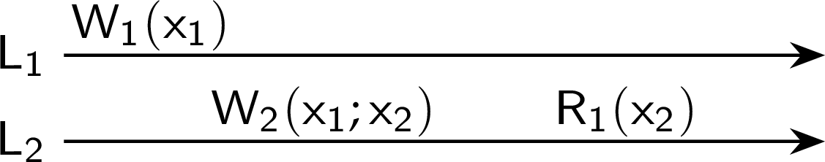

Read your writes
Consistency and replication Client-centric consistency models
Definition
The effect of a write operation by a process on a data item x , will always be seen by a successive read operation on x by the same process.
OK
Not OK
Read your writes

Slide 32
Read your writes
Consistency and replication Client-centric consistency models
Definition
The effect of a write operation by a process on a data item x , will always be seen by a successive read operation on x by the same process.
OK
Not OK
Example
Updating your Web page and guaranteeing that your Web browser shows the newest version instead of its cached copy.
Read your writes

Slide 33
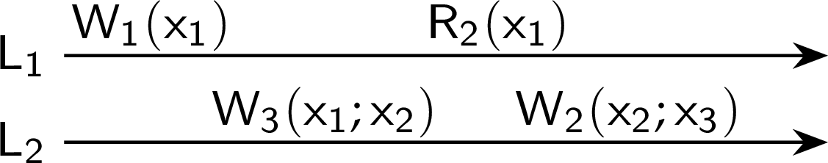

Writes follow reads
Consistency and replication Client-centric consistency models
Definition
A write operation by a process on a data item x following a previous read operation on x by the same process, is guaranteed to take place on the same or a more recent value of x that was read.
OK
Not OK
Writes follow reads

Slide 34
Writes follow reads
Consistency and replication Client-centric consistency models
Definition
A write operation by a process on a data item x following a previous read operation on x by the same process, is guaranteed to take place on the same or a more recent value of x that was read.
OK
Not OK
Example
See reactions to posted articles only if you have the original posting (a read “pulls in” the corresponding write operation).
Writes follow reads

Slide 35
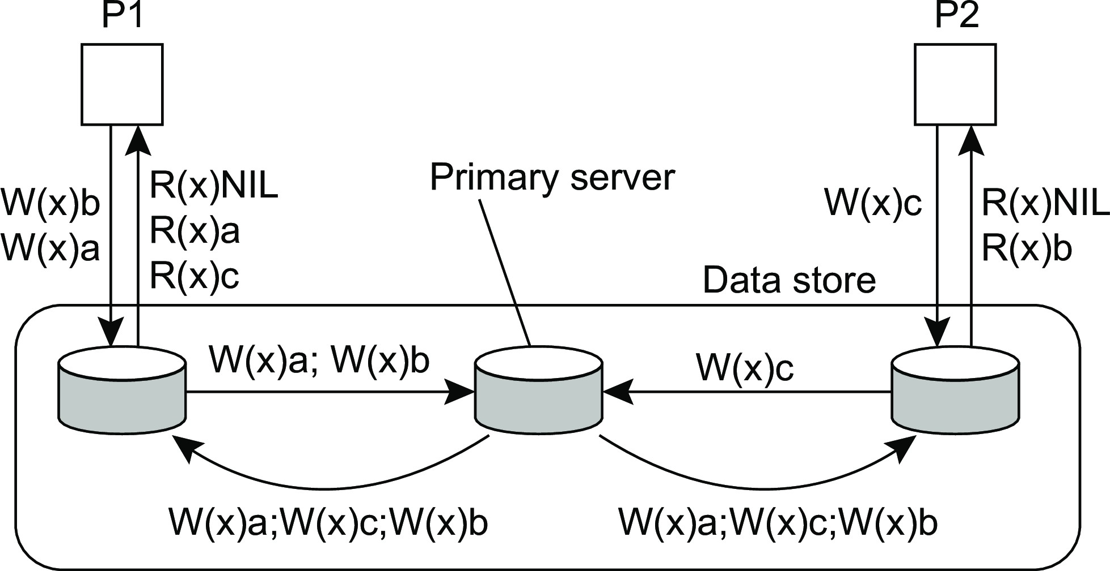
Example: ZooKeeper consistency
Consistency and replication Client-centric consistency models
Yet another model?
ZooKeeper’s consistency model mixes elements of data-centric and client-centric models
Take a naive example
Example: client-centric consistency in ZooKeeper

Slide 36
Consistency and replication
Replica management
Replica placement
Essence
Figure out what the best K places are out of N possible locations.
Finding the best server location

Slide 37
Replica placement
Consistency and replication Replica management
Essence
Figure out what the best K places are out of N possible locations.
Select best location out of N −K for which the average distance to clients is minimal. Then choose the next best server. (Note: The first chosen location minimizes the average distance to all clients.) Computationally expensive.
Finding the best server location

Slide 38
Replica placement
Consistency and replication Replica management
Essence
Figure out what the best K places are out of N possible locations.
Select best location out of N −K for which the average distance to clients is minimal. Then choose the next best server. (Note: The first chosen location minimizes the average distance to all clients.) Computationally expensive.
Select the K -th largest autonomous system and place a server at the best-connected host. Computationally expensive.
Finding the best server location

Slide 39
Replica placement
Consistency and replication Replica management
Essence
Figure out what the best K places are out of N possible locations.
Select best location out of N −K for which the average distance to clients is minimal. Then choose the next best server. (Note: The first chosen location minimizes the average distance to all clients.) Computationally expensive.
Select the K -th largest autonomous system and place a server at the best-connected host. Computationally expensive.
Position nodes in a d -dimensional geometric space, where distance reflects latency. Identify the K regions with highest density and place a server in every one. Computationally cheap.
Finding the best server location

Slide 40
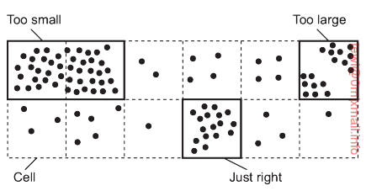
Replica placement
Consistency and replication Replica management
Essence
Identify regions (where content is most demanded, and internode latency is low), place replicas in the identified regions.
Problem
Too large cell => multiple clusters in same node
Too small cell => multiple replicas at same space
Finding the best server location

Slide 41
Content replication
Consistency and replication Replica management
Distinguish different processes
A process is capable of hosting a replica of an object or data:
Permanent replicas: Process/machine always having a replica
Server-initiated replica: Process that can dynamically host a replica on request of another server in the data store
Client-initiated replica: Process that can dynamically host a replica on request of a client (client cache)
Content replication and placement

Slide 42
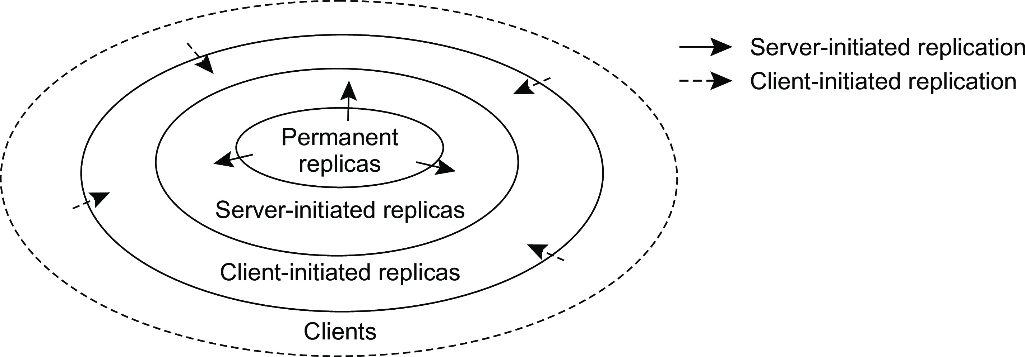
Content replication
Consistency and replication Replica management
The logical organization of different kinds of copies of a data store into three concentric rings
Content replication and placement

Slide 43
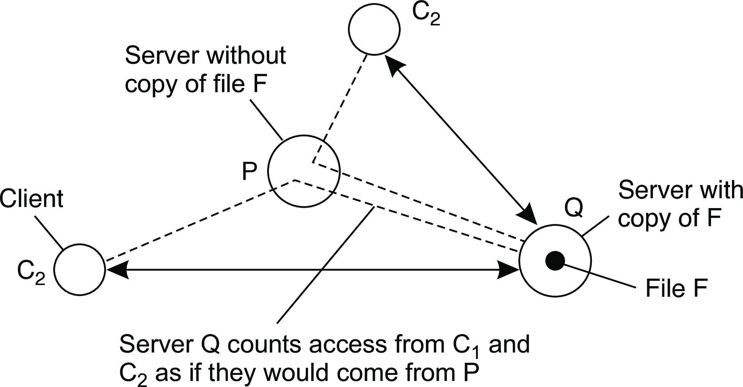
Consistency and replication
Replica management
Server-initiated replicas
Counting access requests from different clients
Keep track of access counts per file, aggregated by considering server closest to requesting clients
Number of accesses drops below threshold D ⇒ drop file
Number of accesses exceeds threshold R ⇒ replicate file
Number of access between D and R ⇒ migrate file
Content replication and placement

Slide 44
Consistency and replication
Replica management
Client-initiated replicas
Client can initiate a request, and local cache can be maintained to store the copy of data
If higher update frequency, avoid caching due to stale copy
If higher read frequency, use caching to improve performance
Cache can be shared among clients in a local area network (difficult to impose)
Content replication and placement

Slide 45
Content distribution
Consistency and replication Replica management
Consider only a client-server combination
Propagate only notification/invalidation of update (often used for caches)
Transfer data from one copy to another (distributed databases): passive replication
Propagate the update operation to other copies: active replication
Note
No single approach is the best, but depends highly on available bandwidth and read-to-write ratio at replicas.
Content distribution
Notes:
Invalidation protocols: Inform other copies that an update has taken place and that the data they contain are no longer valid.
Active replication consumes less bandwidth

Slide 46
Content distribution: client/server system
Consistency and replication Replica management
A comparison between push-based and pull-based protocols in the case of multiple-client, single-server systems
Pushing updates: server-initiated approach, in which update is propagated regardless whether target asked for it.
Pulling updates: client-initiated approach, in which client requests to be updated.
Issue | Push-based | Pull-based
1: | List of client caches | None
2: | Update (and possibly fetch update) | Poll and update
3: | Immediate (or fetch-update time) | Fetch-update time
1: State at server 2: Messages to be exchanged 3: Response time at the client
Content distribution

Slide 47
Content distribution
Consistency and replication Replica management
Observation
We can dynamically switch between pulling and pushing using leases: A contract in which the server promises to push updates to the client until the lease expires.
Make lease expiration time adaptive
Content distribution

Slide 48
Content distribution
Consistency and replication Replica management
Observation
We can dynamically switch between pulling and pushing using leases: A contract in which the server promises to push updates to the client until the lease expires.
Make lease expiration time adaptive
Age-based leases: An object that hasn’t changed for a long time, will not change in the near future, so provide a long-lasting lease
Content distribution

Slide 49
Content distribution
Consistency and replication Replica management
Observation
We can dynamically switch between pulling and pushing using leases: A contract in which the server promises to push updates to the client until the lease expires.
Make lease expiration time adaptive
Renewal-frequency based leases: The more often a client requests a specific object, the longer the expiration time for that client (for that object) will be
Content distribution

Slide 50
Content distribution
Consistency and replication Replica management
Observation
We can dynamically switch between pulling and pushing using leases: A contract in which the server promises to push updates to the client until the lease expires.
Make lease expiration time adaptive
State-based leases: The more loaded a server is, the shorter the expiration times become
Content distribution

Slide 51
Content distribution
Consistency and replication Replica management
Observation
We can dynamically switch between pulling and pushing using leases: A contract in which the server promises to push updates to the client until the lease expires.
Make lease expiration time adaptive
Age-based leases: An object that hasn’t changed for a long time, will not change in the near future, so provide a long-lasting lease
Renewal-frequency based leases: The more often a client requests a specific object, the longer the expiration time for that client (for that object) will be
State-based leases: The more loaded a server is, the shorter the expiration times become
Question
Why are we doing all this?
Content distribution

Slide 52
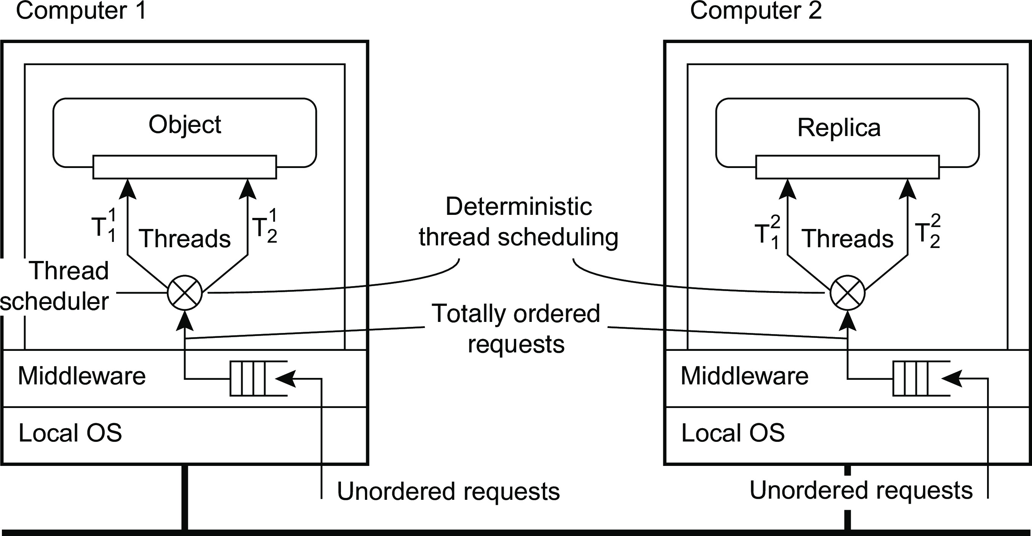
Managing replicated objects
Consistency and replication Replica management
Prevent concurrent execution of multiple invocations on the same object: access to the internal data of an object has to be serialized. Using local locking mechanisms are sufficient.
Ensure that all changes to the replicated state of the object are the same: no two independent method invocations take place on different replicas at the same time: we need deterministic thread scheduling.
Managing replicated objects

Slide 53
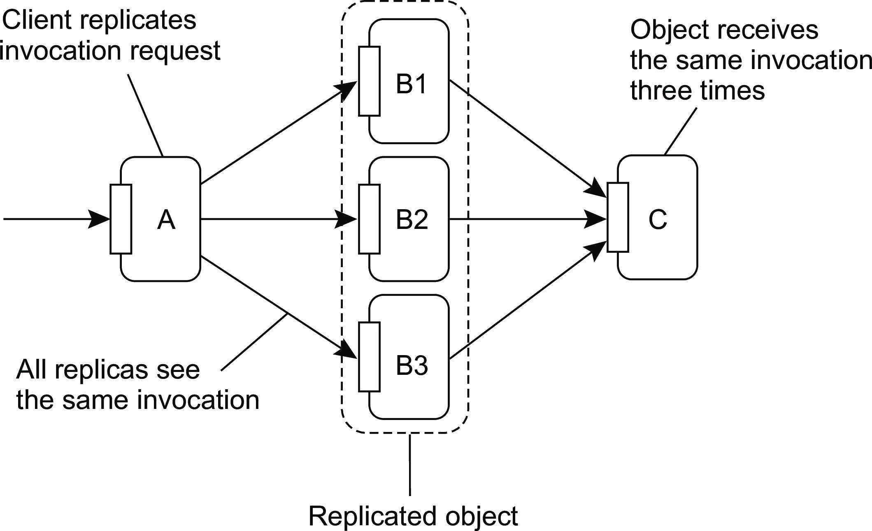
Consistency and replication
Replica management
Replicated-object invocations
Problem when invocating a replicated object
Managing replicated objects
Notes:
Method C is transaction of $100,000 and it can make result inconsistent due to call by multiple replicas of method ‘B’

Slide 54
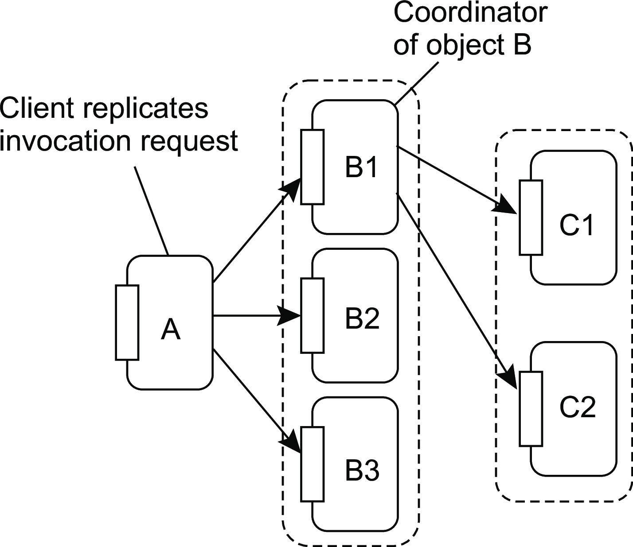
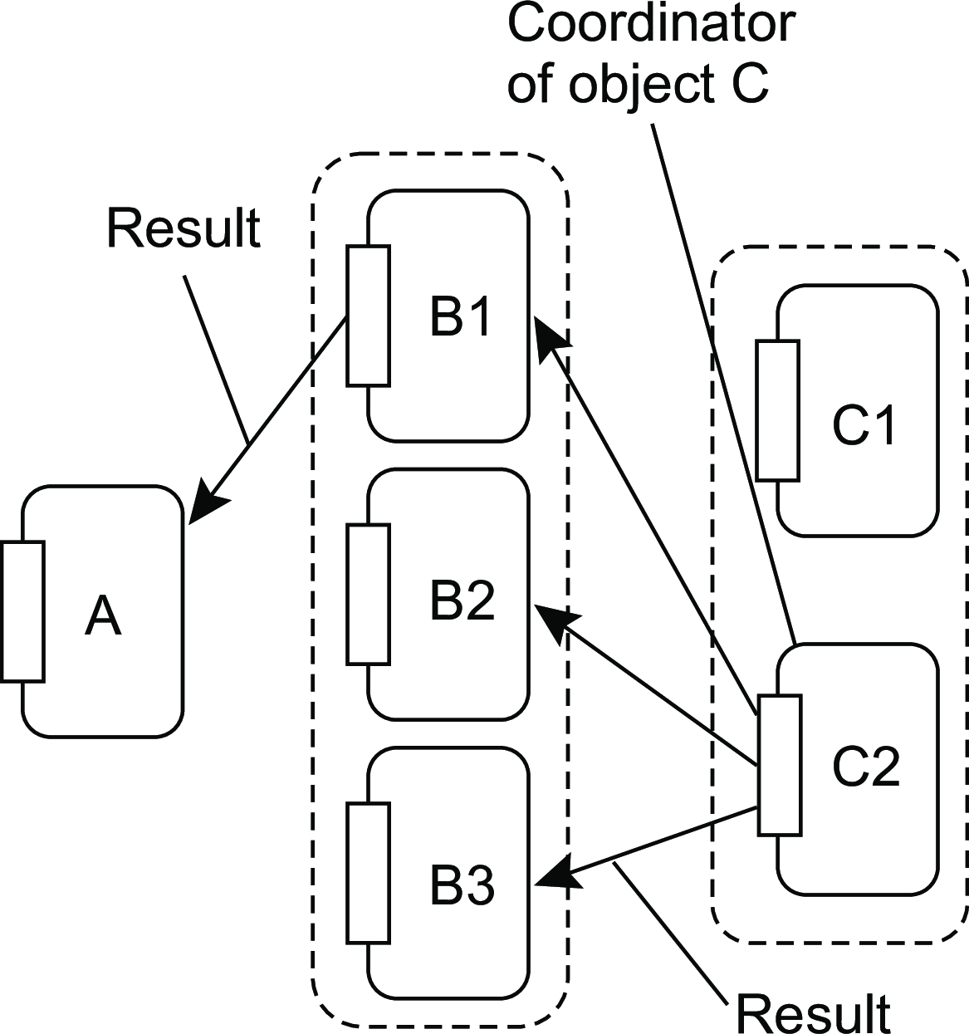
Consistency and replication
Replica management
Replicated-object invocations
Forwarding a request
Returning the reply
Managing replicated objects
Notes:
One replica acts as coordinator and performs forwarding actions.

Slide 55
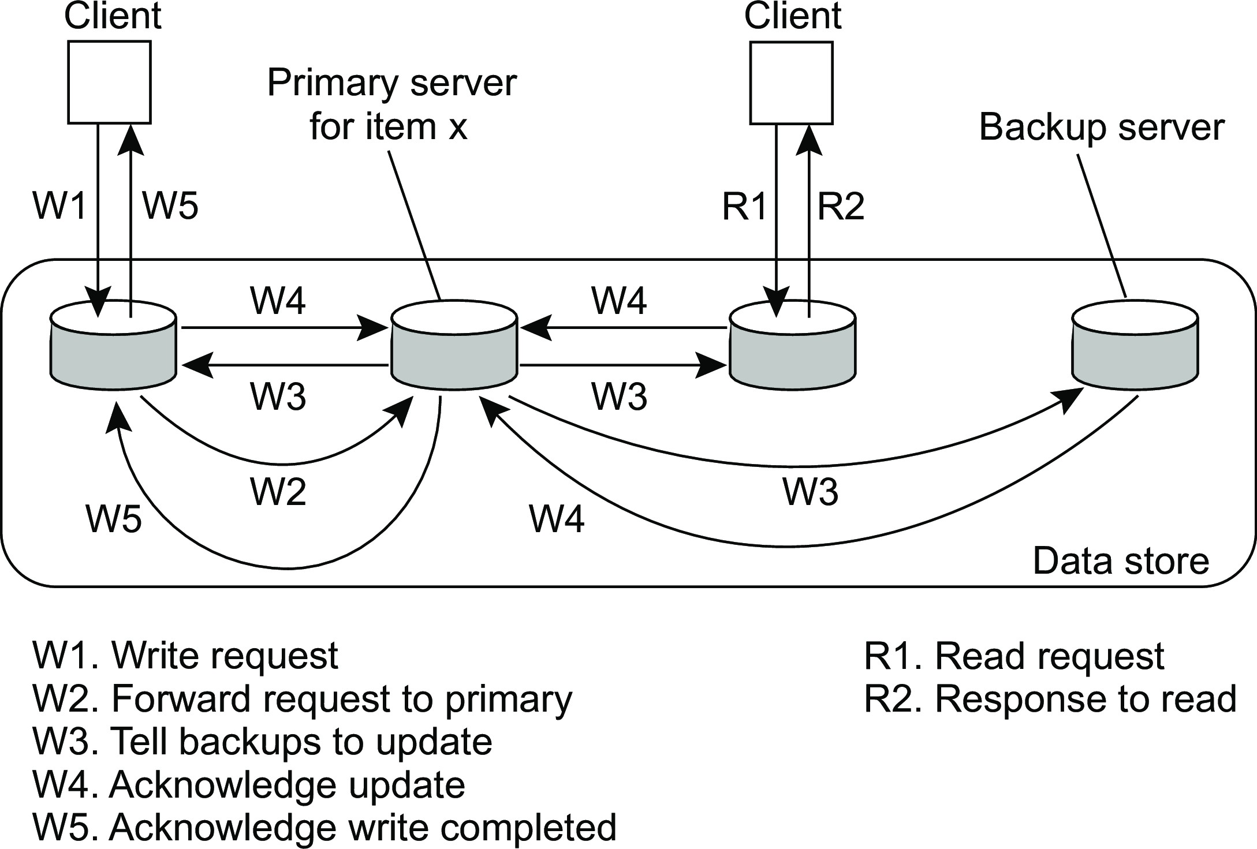
Consistency and replication
Consistency protocols
Primary-based protocols
Primary-backup protocol
Sequential consistency: Primary-based protocols

Slide 56
Consistency and replication
Consistency protocols
Primary-based protocols
Primary-backup protocol
Example primary-backup protocol
Traditionally applied in distributed databases and file systems that require a high degree of fault tolerance. Replicas are often placed on the same LAN.
Sequential consistency: Primary-based protocols

Slide 57
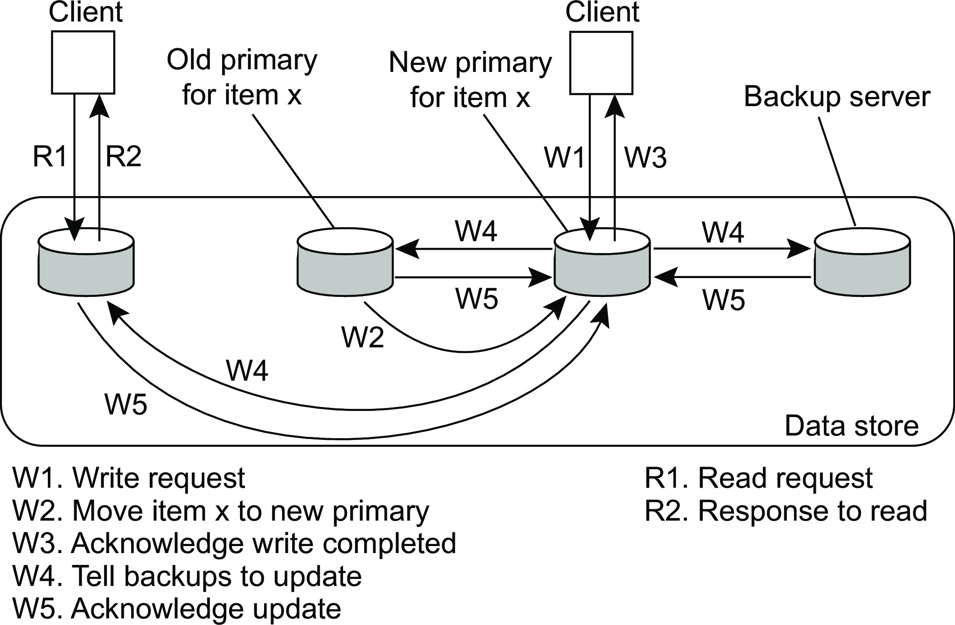
Consistency and replication
Consistency protocols
Primary-based protocols
Primary-backup protocol with local writes
Sequential consistency: Primary-based protocols

Slide 58
Consistency and replication
Consistency protocols
Primary-based protocols
Primary-backup protocol with local writes
Example primary-backup protocol with local writes
Mobile computing in disconnected mode (ship all relevant files to user before disconnecting, and update later on).
Sequential consistency: Primary-based protocols

Slide 59
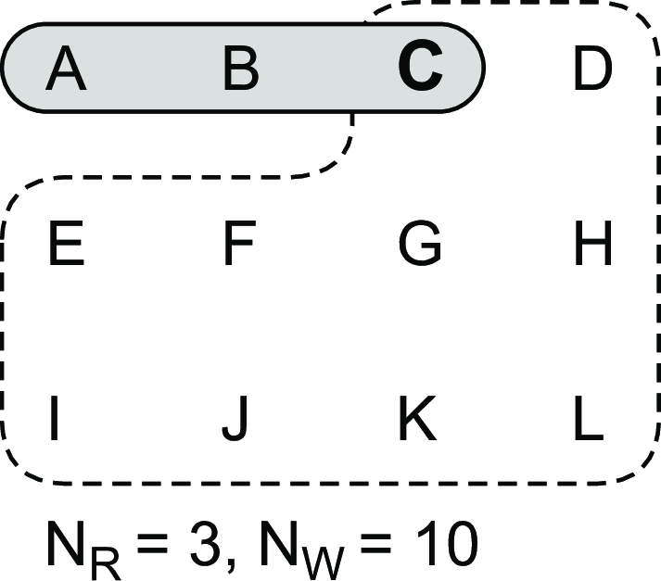
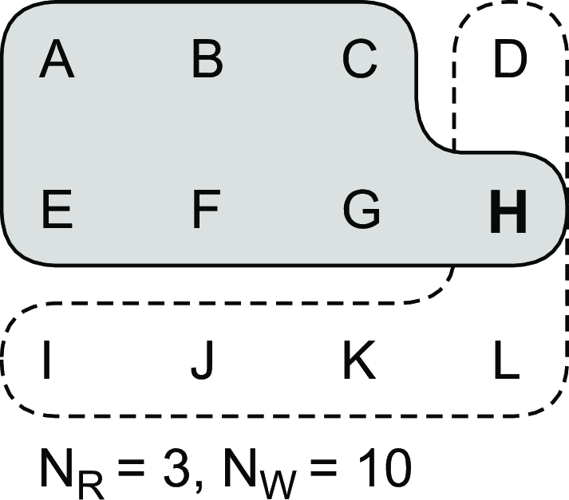
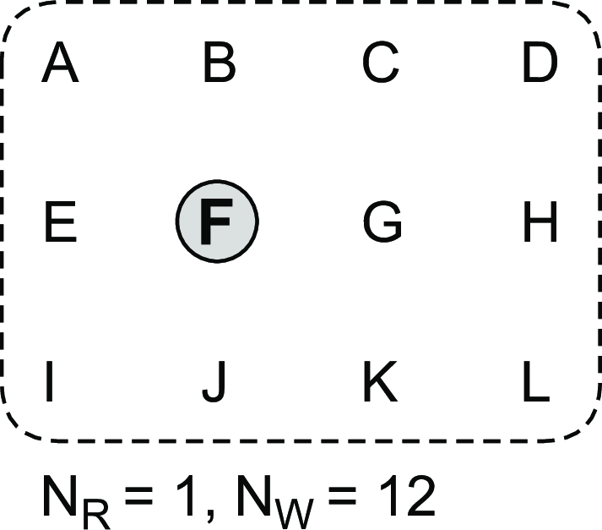
Replicated-write protocols
Consistency and replication Consistency protocols
Quorum-based protocols
Assume N replicas. Ensure that each operation is carried out in such a way that a majority vote is established: distinguish read quorum N_{R} and write quorum N_{W} . Ensure:
N_{R} + N_{W} > N (prevent read-write conflicts)
N_{W} > N/2 (prevent write-write conflicts)
Correct
Write-write conflict
Correct (ROWA)
Sequential consistency: Replicated-write protocols
Notes:
Quorum: Maximum number of processes required to accomplish the task

Slide 60
Continuous consistency: Numerical errors
Consistency and replication Consistency protocols
Principal operation
Every server S_{i} has a log, denoted as L_{i} .
Consider a data item x and let val (W ) denote the numerical change in its value after a write operation W . Assume that
∀W : val (W ) > 0
W is initially forwarded to one of the N replicas, denoted as origin(W ). TW [i, j ] are the writes executed by server S_{i} that originated from S_{j} :
TW [i, j ] = ∑{val (W )|origin(W ) = S_{j} & W ∈ L_{i} }
Implementing continuous consistency

Slide 61
Consistency and replication
Consistency protocols
Continuous consistency: Numerical errors
Note
Actual value v (t ) of x :
N
v (t ) = v_{init} + ∑ TW [k, k ]
k =1
value v_{i} of x at server S_{i} :
N
v_{i} = v_{init} + ∑ TW [i, k ]
k =1
Implementing continuous consistency

Slide 62
Consistency and replication
Consistency protocols
Continuous consistency: Numerical errors
Problem
We need to ensure that v (t ) −v_{i} < δ_{i} for every server S_{i} .
Implementing continuous consistency

Slide 63
Continuous consistency: Numerical errors
Consistency and replication Consistency protocols
Problem
We need to ensure that v (t ) −v_{i} < δ_{i} for every server S_{i} .
Approach
Let every server S_{k} maintain a view TW_{k} [i, j ] of what it believes is the value of
TW [i, j ]. This information can be gossiped when an update is propagated.
Implementing continuous consistency

Slide 64
Continuous consistency: Numerical errors
Consistency and replication Consistency protocols
Problem
We need to ensure that v (t ) −v_{i} < δ_{i} for every server S_{i} .
Approach
Let every server S_{k} maintain a view TW_{k} [i, j ] of what it believes is the value of
TW [i, j ]. This information can be gossiped when an update is propagated.
Note
0 ≤ TW_{k} [i, j ] ≤ TW [i, j ] ≤ TW [j, j ]
Implementing continuous consistency

Slide 65
Continuous consistency: Numerical errors
Consistency and replication Consistency protocols
Solution
S_{k} sends operations from its log to S_{i} when it sees that TW_{k} [i, k ] is getting too far from TW [k, k ], in particular, when
TW [k, k ] −TW_{k} [i, k ] > δ_{i} /(N − 1)
Implementing continuous consistency

Slide 66
Continuous consistency: Numerical errors
Consistency and replication Consistency protocols
Solution
S_{k} sends operations from its log to S_{i} when it sees that TW_{k} [i, k ] is getting too far from TW [k, k ], in particular, when
TW [k, k ] −TW_{k} [i, k ] > δ_{i} /(N − 1)
Question
To what extent are we being pessimistic here: where does δ_{i} /(N − 1) come from?
Implementing continuous consistency

Slide 67
Continuous consistency: Numerical errors
Consistency and replication Consistency protocols
Solution
S_{k} sends operations from its log to S_{i} when it sees that TW_{k} [i, k ] is getting too far from TW [k, k ], in particular, when
TW [k, k ] −TW_{k} [i, k ] > δ_{i} /(N − 1)
Question
To what extent are we being pessimistic here: where does δ_{i} /(N − 1) come from?
Note
Staleness can be done analogously, by essentially keeping track of what has been seen last from S_{i} (see book).
Implementing continuous consistency

Slide 68
Implementing client-centric consistency
Consistency and replication Consistency protocols
Keeping it simple
Each write operation W is assigned a globally unique identifier by its origin server. For each client, we keep track of two sets of writes:
Read set: the (identifiers of the) writes relevant for that client’s read operations
Write set: the (identifiers of the) client’s write operations.
Implementing client-centric consistency

Slide 69
Implementing client-centric consistency
Consistency and replication Consistency protocols
Keeping it simple
Each write operation W is assigned a globally unique identifier by its origin server. For each client, we keep track of two sets of writes:
Read set: the (identifiers of the) writes relevant for that client’s read operations
Write set: the (identifiers of the) client’s write operations.
Monotonic-read consistency
When client C wants to read at server S, C passes its read set. S can pull in any updates before executing the read operation, after which the read set is updated.
Implementing client-centric consistency

Slide 70
Implementing client-centric consistency
Consistency and replication Consistency protocols
Keeping it simple
Each write operation W is assigned a globally unique identifier by its origin server. For each client, we keep track of two sets of writes:
Read set: the (identifiers of the) writes relevant for that client’s read operations
Write set: the (identifiers of the) client’s write operations.
Monotonic-read consistency
When client C wants to read at server S, C passes its read set. S can pull in any updates before executing the read operation, after which the read set is updated.
Monotonic-write consistency
When client C wants to write at server S, C passes its write set. S can pull in any updates, executes them in the correct order, and then executes the write operation, after which the write set is updated.
Implementing client-centric consistency

Slide 71
Implementing client-centric consistency
Consistency and replication Consistency protocols
Read-your-writes consistency
When client C wants to read at server S, C passes its write set. S can pull in any updates before executing the read operation, after which the read set is updated.
Implementing client-centric consistency

Slide 72
Implementing client-centric consistency
Consistency and replication Consistency protocols
Read-your-writes consistency
When client C wants to read at server S, C passes its write set. S can pull in any updates before executing the read operation, after which the read set is updated.
Writes-follows-reads consistency
When client C wants to write at server S, C passes its read set. S can pull in any updates, executes them in the correct order, and then executes the write operation, after which the write set is updated.
Implementing client-centric consistency

Slide 73
Consistency and replication
Example: Caching and replication in the Web
Example: replication in the Web
Client-side caches
In the browser
At a client’s site, notably through a Web proxy
Caches at ISPs
Internet Service Providers also place caches to (1) reduce cross-ISP traffic and (2) improve client-side performance. May get nasty when a request needs to pass many ISPs.

Slide 74
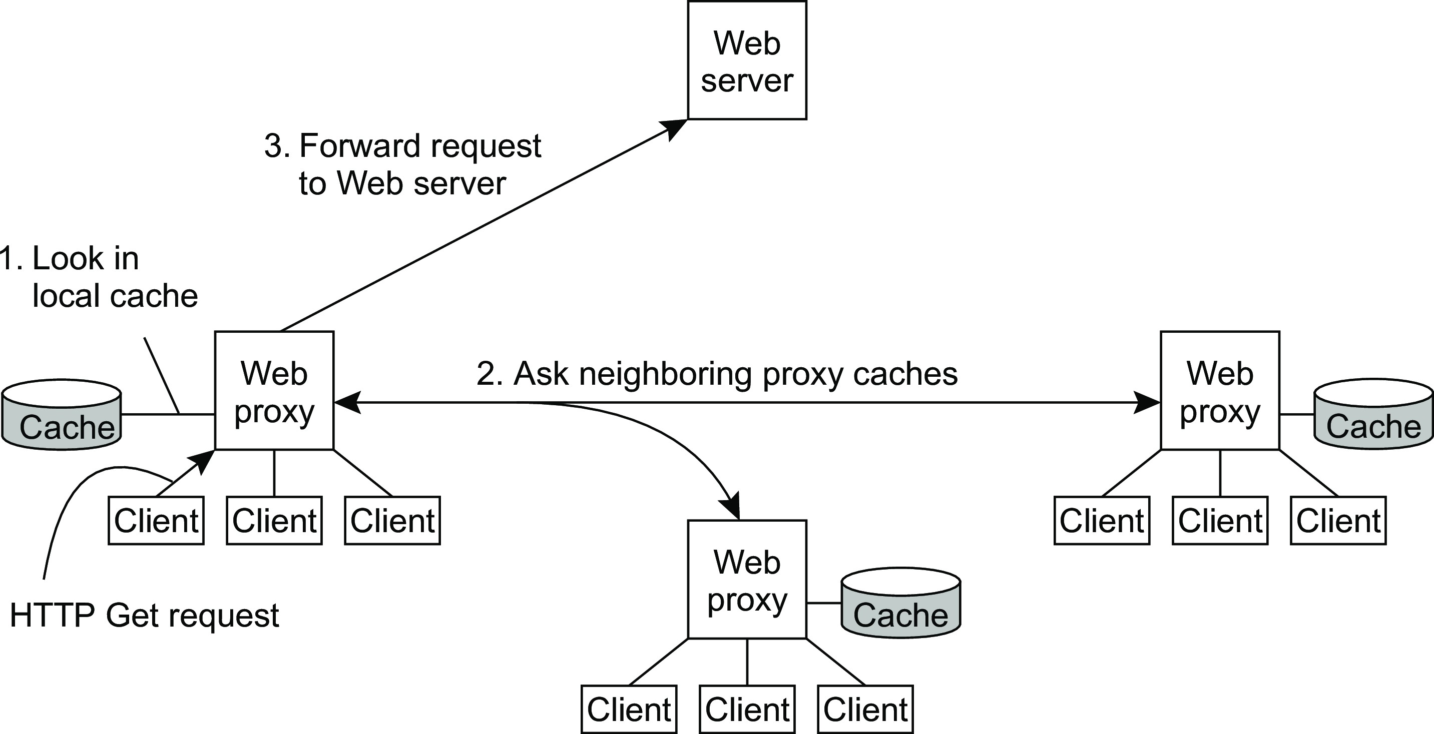
Consistency and replication
Example: Caching and replication in the Web
Cooperative caching
Whenever a cache miss occurs at a Web Proxy, the proxy first checks a number of neighboring proxies to see if one of them contains the requested document. If such a check fails, the proxy forwards the request to the Web Server responsible for the document. It is traditionally deployed with Web Cache belonging to the same organization or institution.

Slide 75
Web-cache consistency
Consistency and replication Example: Caching and replication in the Web
How to guarantee freshness?
To prevent that stale information is returned to a client:
Option 1: let the cache contact the original server to see if content is still up to date.
Option 2: Assign an expiration time T_{expire} that depends on how long ago the document was last modified when it is cached. If T_{last modified} is the last modification time of a document (as recorded by its owner), and T_{cached} is the time it was cached, then
^{T}expire ^{= α(T}cached ^{−T}last modified^{) + T}cached
with α = 0.2. Until T_{expire}, the document is considered valid.

Slide 76
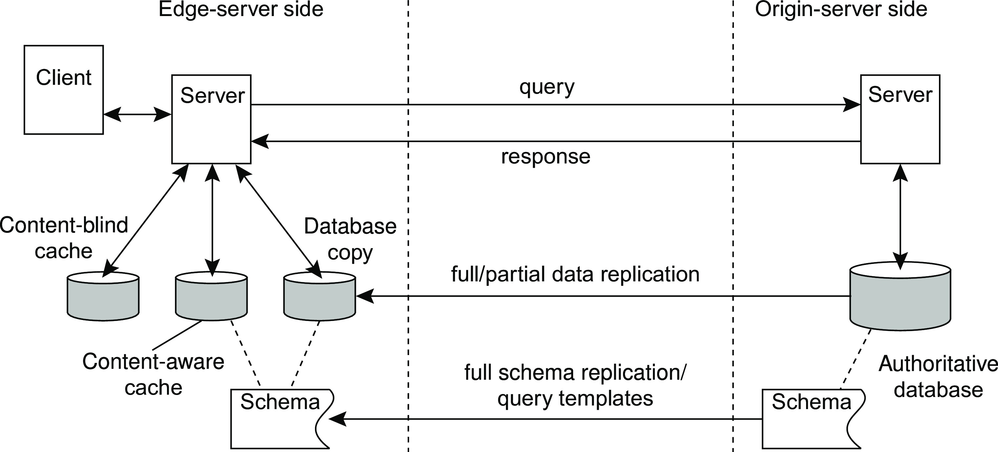
Consistency and replication
Example: Caching and replication in the Web
Alternatives for caching and replication
Database copy: the edge has the same as the origin server
Content-aware cache: check if a (normal query) can be answered with cached data. Requires that the server knows about which data is cached at the edge.
Content-blind cache: store a query, and its result. When the exact same query is issued again, return the result from the cache.
Notes:
Replication depends on read/update ratio.

